Slide 1
生成式AI技術與數位行銷人才養成班 人工智慧概論
謝欽旭
國立高雄科技大學電子工程系
2025

Slide 2
USING ARTIFICIAL INTELLIGENCE
Like computing, Al has become a general-purpose technology, and has uses in a wide range of fields, from fine art to high-tech weapons design.
It is most effective when it is used as a tool to assist—rather than replace— human experts, and when very large quantities of data are involved.
Sometimes, just one Al technique is required to perform a task, while other applications use a combination of techniques

Slide 3
USES OF Al - APPLICATIONS OF Al
Whether via mobile phones or virtual assistants, we interact with Al applications everywhere—often without realizing it.
Using these applications has changed the way we work, shop, and communicate, and has revolutionized many industries, including finance, healthcare, and agriculture.
Other AI technologies, such as generative Al and autonomous weaponry, are still in their infancy, but these too will soon be in mainstream use.

Slide 4
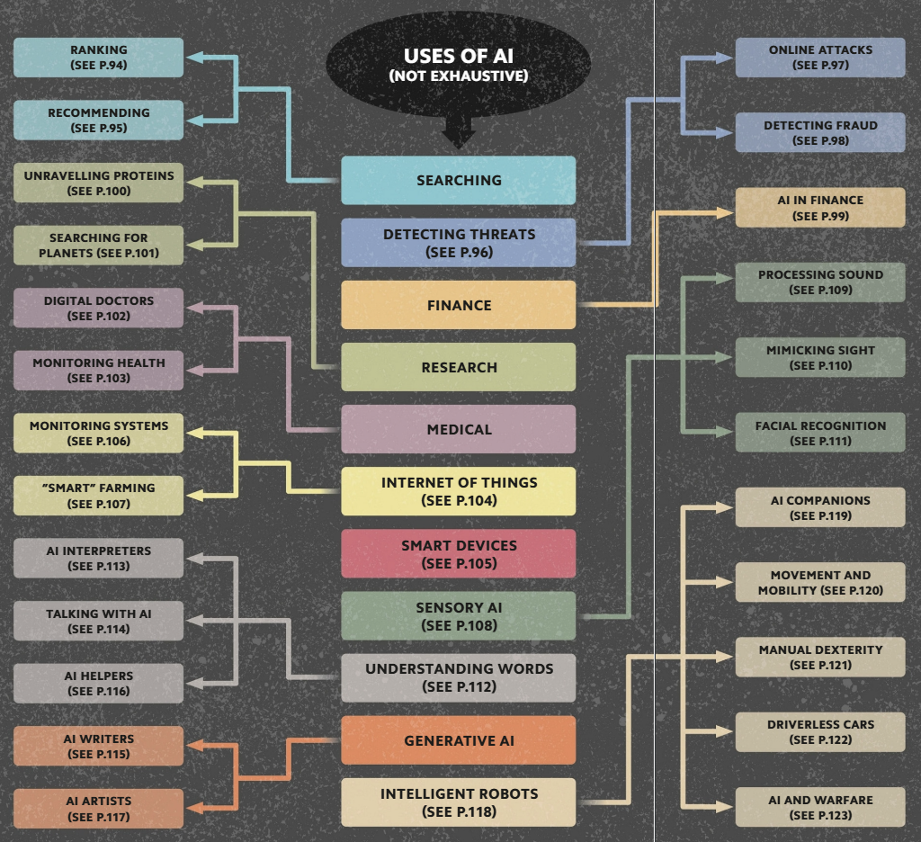

Slide 5
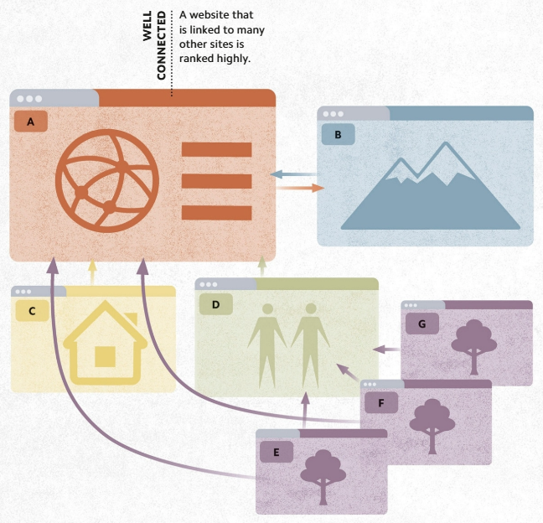
RANKING - DATA HIERARCHIES
When an internet search engine is used, Al-generated rankings determine which sites appear most highly in the results.
Algorithms rank websites more highly if they are accessed from many other sites, or if they are especially popular.

Slide 6
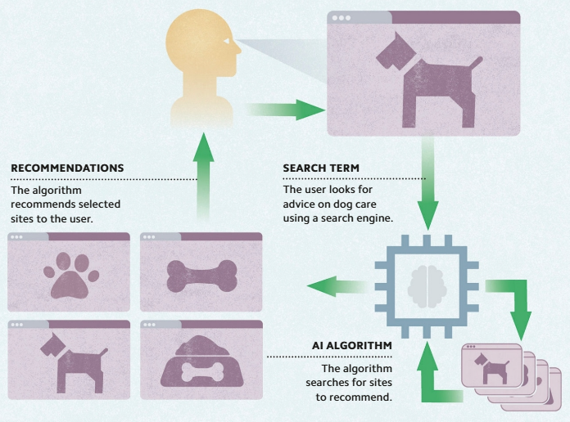
RECOMMENDING - TAILORED CONTENT
Based on an internet user's browsing history, and that of others, Al recommendation algorithms can suggest websites, as well as products, that may interest the user.
This can involve suggesting similar content to what the user has viewed previously or offering sites that similar web users have visited.

Slide 7
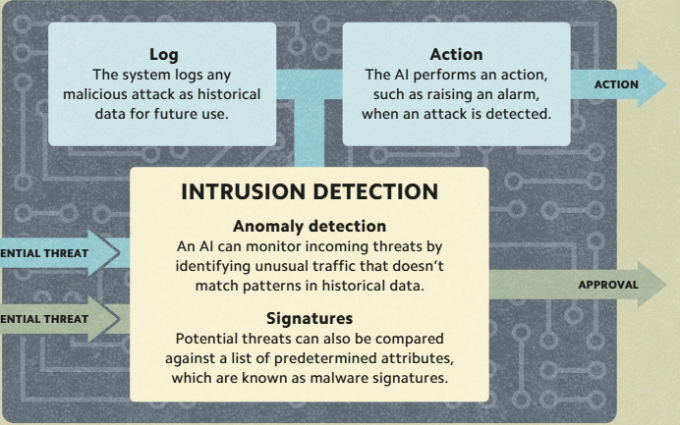
DETECTING THREATS - CYBERSECURITY
Traditional threat detection software used by cybersecurity experts searches for known malware “signatures,” blocks the malware files it detects, and raises alerts.
Incorporating an Al into the system enables cyber defenses to identify and categorize new and mutated threats (“zero-day” malware) that would otherwise be undetectable since they do not match any known signatures

Slide 8
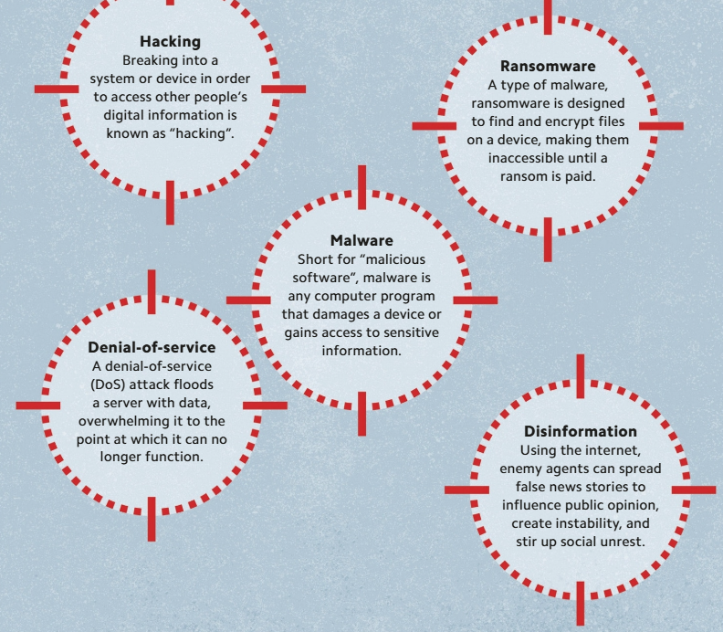
ONLINE ATTACKS - CYBER WARFARE
The use of cyberattacks to target a nation state is known as “cyber warfare.“
It is possible to inflict serious harm on a country remotely, disrupting key services and critical infrastructure such as power grids by disabling the information systems that control them.
Cyber warfare tactics include denial-of-service (DoS) attacks, malware such as viruses and ransomware disinformation campaigns, and state-sponsored hacking.
Al is used in cyber warfare to enhance these attacks, making
them faster and more sophisticated

Slide 9
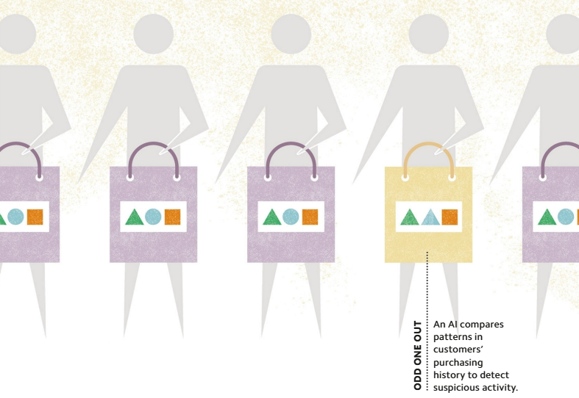
DETECTING FRAUD - TRANSACTION MONITORING
Financial institutions are adopting Al systems to detect—and prevent—fraud.
These systems can process vast amounts of data about past transactions, learning the ordinary patterns of behavior of a bank's customers.
An Al may score each transaction on its likelihood of being fraudulent, then raise an alert when this score exceeds a certain threshold.

Slide 10
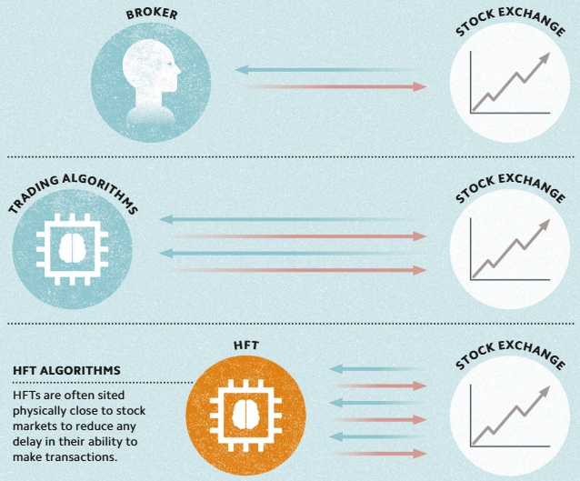
Al IN FINANCE - ALGORITHMIC TRADING
High-frequency trading (HFT) is the use of specialized algorithms to make investment decisions and transactions at superhuman speed—performing millions of trades each day.
Some financial institutions manage entire investment portfolios using HFT. By evaluating vast quantities of market data in real time, it can identify the best stocks and shares to buy and sell, identify the optimal time to place those deals, and perform transactions extremely quickly.

Slide 11
UNRAVELING PROTINS - MEDICAL RESEARCH
Als not only speed up tedious work, they help open up new fields of scientific research.
For example, using deep learning and painstakingly collected experimental data, scientists have taught Als to predict the 3D structure of "folded proteins"—the building blocks of life—with atomic precision.
This "protein folding problem" was so complex that it remained unsolved for decades. Today, understanding how these proteins work has transformed medical research and accelerated the process of developing new drugs.

Slide 12
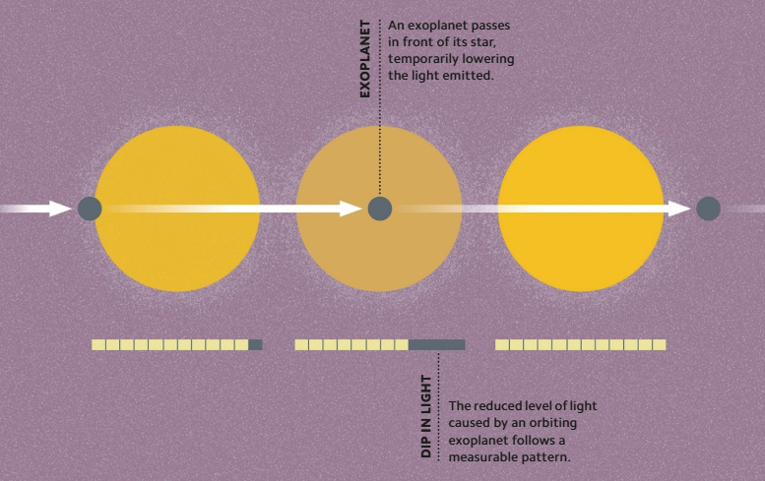
SEARCHING FOR PLANETS - ASTRONOMICAL RESEARCH
Al is a powerful tool in scientific research, enabling scientists to look for interesting phenomena in enormous quantities of data.
For example, in astronomy, Als are used to classify galaxies, look for gravitational waves, and identify "exoplanets" with high accuracy.

Slide 13
DIGITAL DOCTORS - AI IN MEDICAL DIAGNOSIS
Al is fast becoming a powerful tool for assisting doctors.
Machine learning, and especially deep learning, has proven effective at identifying disease in medical imagery, including finding signs of lung cancer on CT scans and detecting retinal problems caused by diabetes using photographs of patients' eyes.
Al is also used to identify people at high risk of certain conditions, prioritize urgent cases, and help doctors to select treatments.

Slide 14
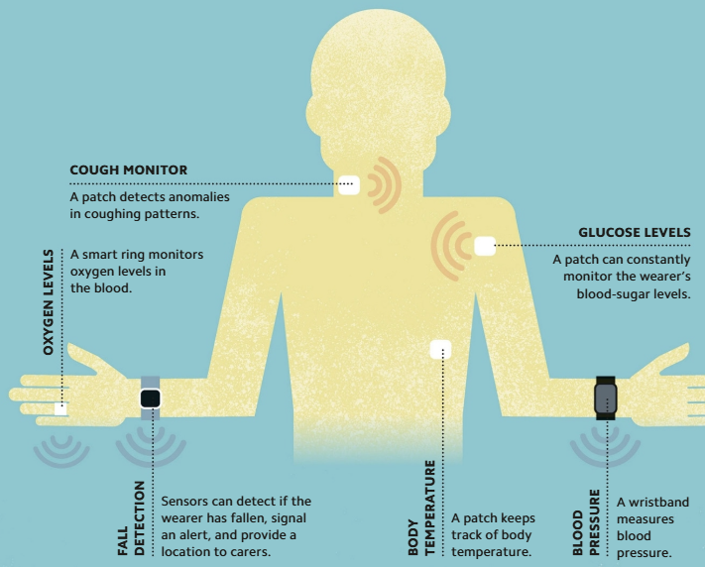
MONITORING HEALTH - Al AND HEALTHCARE
Als perform an important role in a new field of medicine known as telehealth.
By wearing sensors that monitor vital bodily functions, such as oxygen intake and blood pressure, a person can go about their day knowing that if a sensor detects a problem, it will send a signal to their digital assistant (an app on their phone or personal computer), which in turn—via the internet—will alert an Al at a healthcare center.

Slide 15
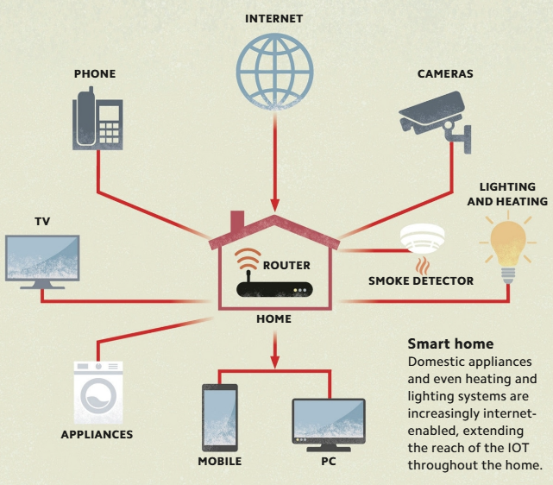
INTERNET OF THINGS - CONNECTED DEVICES
The "Internet of Things" (IoT) is the network of interconnected devices that collect and exchange data via the internet—not only phones and computers, but also smart refrigerators, driverless cars, fitness monitors, security cameras, and tens of billions of other items.
Due to the vast amounts of data that these devices collect—and the requirement that they respond appropriately to their users and environment—Als have become integral to the IoT

Slide 16
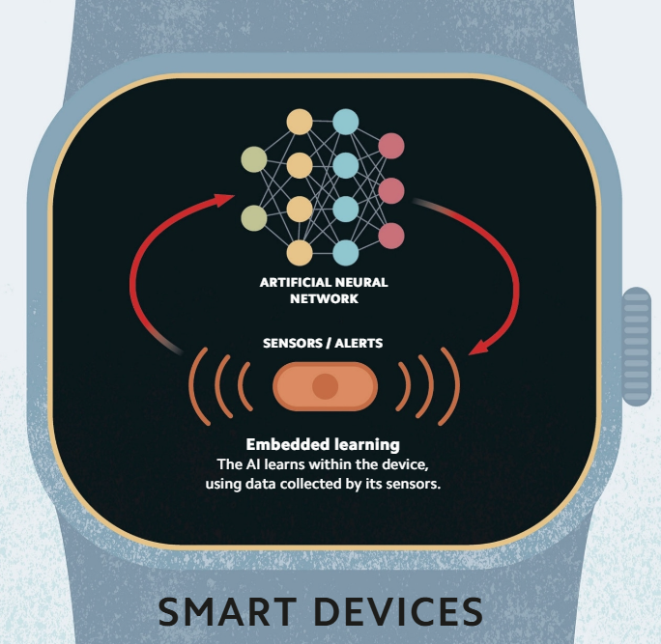
SMART DEVICES - EMBEDDED Al
The "intelligence" in the Internet of Things is mostly contained within clouds—remote computing systems usually owned by technology companies.
Increasingly, however, Al software capable of machine- and deep learning is being embedded in devices, such as mobile phones and smart watches.
Using embedded Al removes the need to send data to and from the cloud continuously, reducing power usage, data processing time, risk of data breaches, and reliance on cloud providers

Slide 17
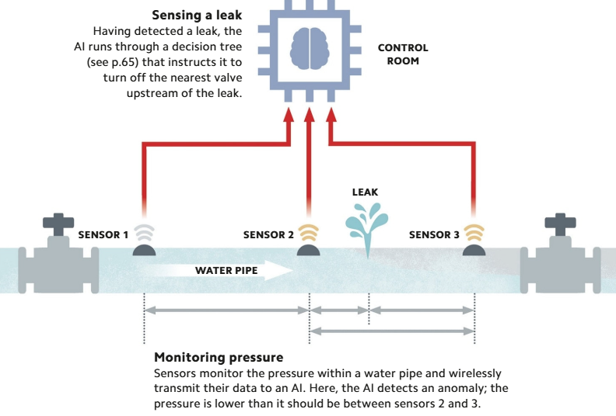
MONITORING SYSTEMS - Al AND INFRASTRUCTURE
The "Internet of Things" enables Als to monitor all kinds of equipment automatically, up to major infrastructure systems, such as gas pipelines, transportation networks, and electricity grids.
Sensors distributed throughout these systems collect and transmit their data to Als, which then scan the data for anomalies and alert human technicians to investigate them further if necessary.
Als are also used to predict where faults could occur in the future, enabling technicians to take action to prevent equipment failure.

Slide 18
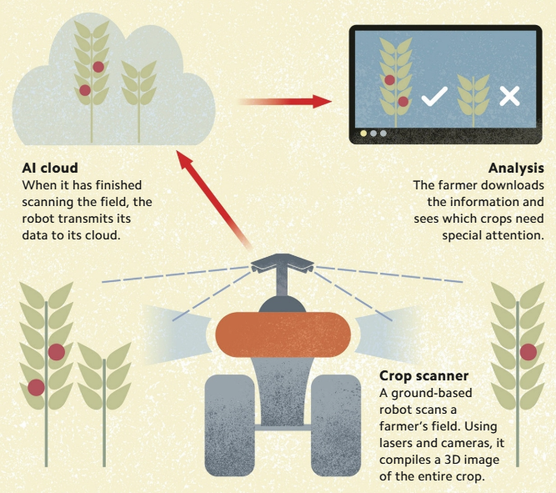
"SMART" FARMING - PRECISION AGRICULTURE
Al is a key technology in "precision agriculture"—an approach to farming that optimizes the use of water and other resources in order to increase yields and minimize waste.
Using devices such as drones in the air and robots on the ground, which collect data analyzed by Als, farmers can receive real-time information about their crops, enabling them to know which of them require water, pesticide, or fertilizer at any time.

Slide 19
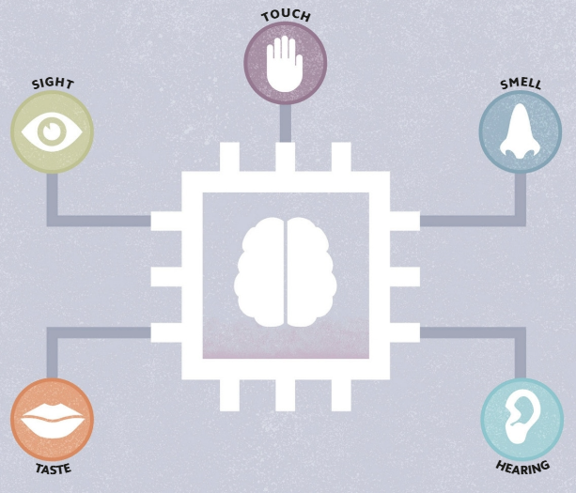
SENSORY Al - MACHINE PERCEPTION
A key aspect of human intelligence is the ability to perceive the world through sight, hearing, touch, smell, and taste.
Machine perception is the ability of computers to sense their surroundings via dedicated hardware (such as cameras and microphones), and to interpret the collected data and act appropriately.
This allows computers to receive information from sources other than a keyboard and a mouse, which is a step toward aligning Al with human intelligence.

Slide 20
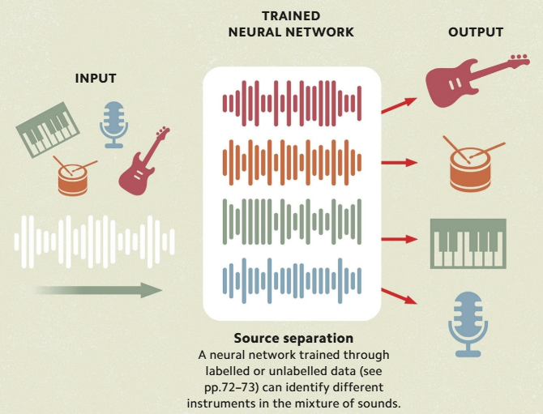
PROCESSING SOUND - MACHINE HEARING
Machine hearing is the ability of a computer to sense and process audio data, such as music or human speech.
This interdisciplinary field employs both classical and statistical approaches to Al.
Speech recognition is a complex subfield within machine hearing. It aims to comprehend meaning in spoken language, often using deep learning to train models.

Slide 21
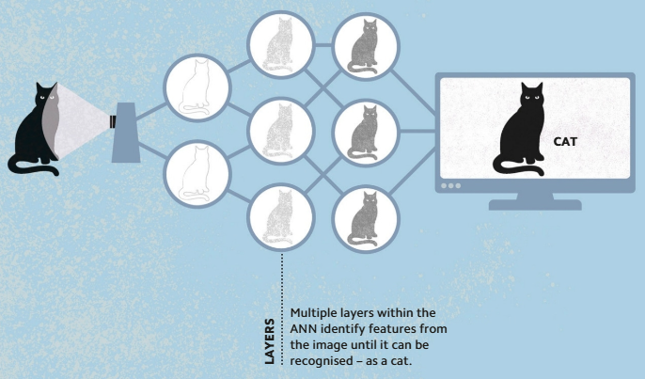
MIMICKING SIGHT - COMPUTER VISION
Computer vision is the ability of a computer to recognize images and videos
Engineers working in computer vision aim to automate the tasks performed by biological visual systems, such as the human eye and parts of the nervous system.
The rise of deep learning using multilayered artificial neural networks and the availability of very large training data sets online have greatly advanced the field.

Slide 22
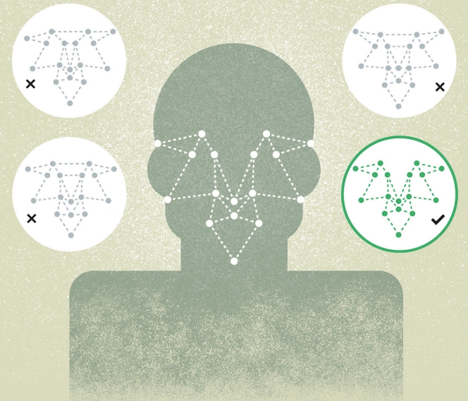
FACIAL RECOGNITION - FEATURING MAPPING
Facial recognition is a form of computer vision technology that matches photographs or videos of human faces to those stored in a database.
An image of a face is captured, and its distinctive features, such as the distance between the eyes, are mapped to create a unique "faceprint" that is then compared with known faceprints.

Slide 23
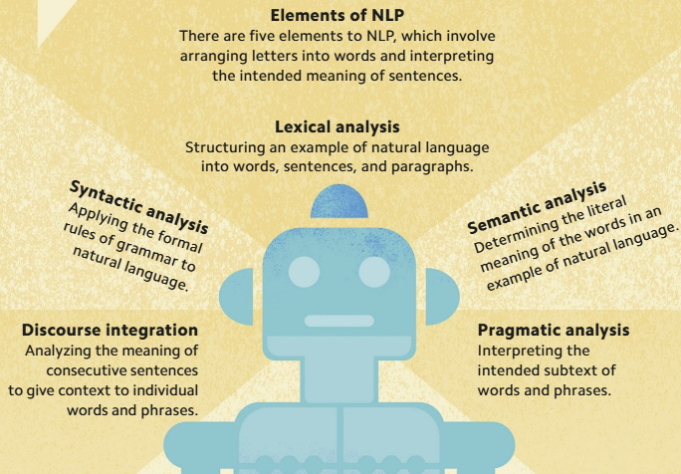
UNDERSTANDING WORDS - NATURAL LANGUAGE PROCESSING
The ability of computers to "understand" and generate natural language—that is, language as it is typically spoken and written by humans—is a key element of mimicking human intelligence.
The explosion in computing power and big data has enabled machine learning—particularly deep learning—to be integrated into NLP with impressive results.

Slide 24
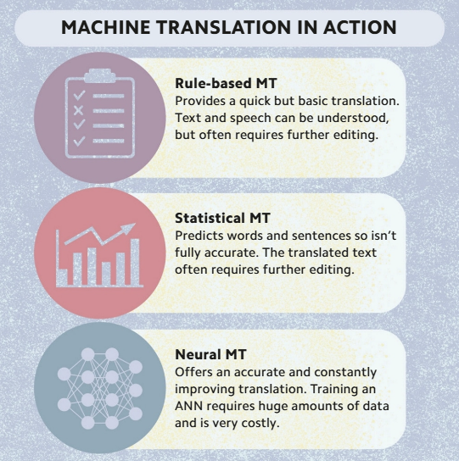
Al INTERPRETERS - MACHINE TRANSLATION
Machine translation (MT) is the use of Al in the automated translation of text or speech from one language to another.
There are three broad approaches:
“rule-based MT” relies on linguistic rules, such as grammar and syntax;
“statistical MT” uses the known relationships between words to predict whole sentences and phrases;
“neural MT” uses artificial neural networks trained to understand languages almost as well as people do.

Slide 25
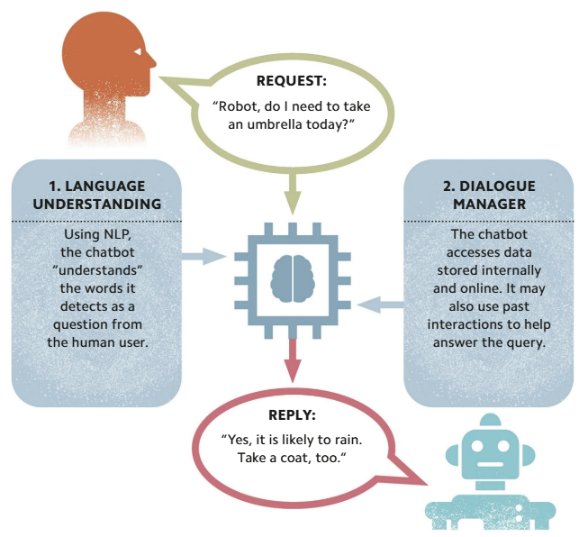
TALKING WITH Al - CHATBOTS
Chatbots, such those employed by virtual, are programs that can carry out conversations via text or text-to-speech.
Natural language processing helps chatbots mimic how humans talk during conversations.
Based on classical Al, statistical Al, or a combination of the two, chatbots can range in sophistication.

Slide 26
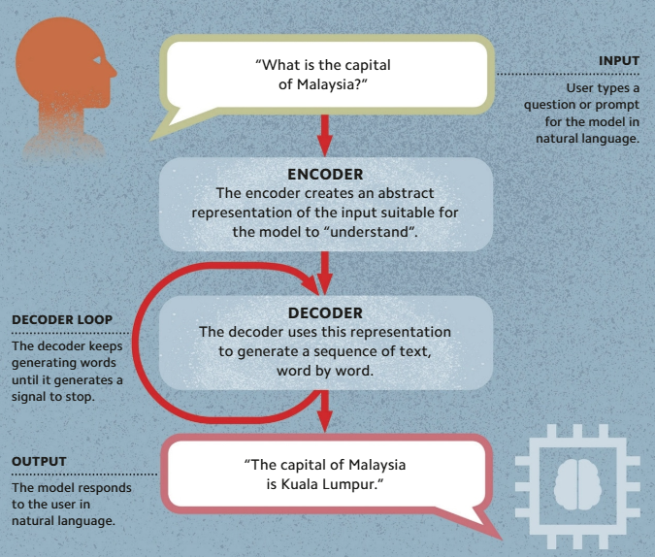
AI WRITER – LARGE LANGUAGE MODEL
Large Language Models (LLMs) are a type of generative Al capable of producing text indistinguishable from text written by humans.
They work by repeatedly predicting the next word in a sequence and are characterized by their vast size, trained using datasets of hundreds of billions of words and containing billions of weights.
LLMs are used to power chatbot applications such as ChatGPT, Google Bard, and Bing Chat.
They are very good at generating human like text, but the text isn't always factually accurate, as the model may have been trained on data containing inaccuracies or.

Slide 27
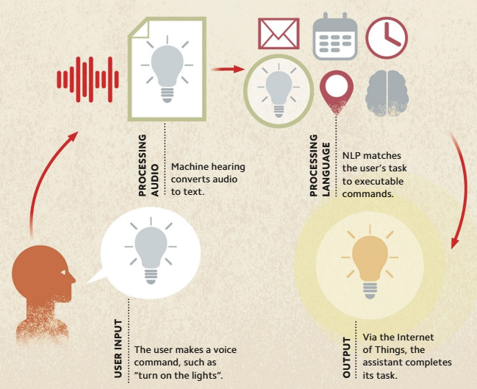
Al HELPERS - VIRTUAL ASSISTANTS
A virtual assistant is a software application or device that uses machine hearing and natural language processing to perform tasks on command, such as searching the internet, playing music, or setting timers and alerts.
Many virtual assistants are cloud-based, and continually use voice data for training, which enables them to get better at predicting a user's needs and preferences.

Slide 28
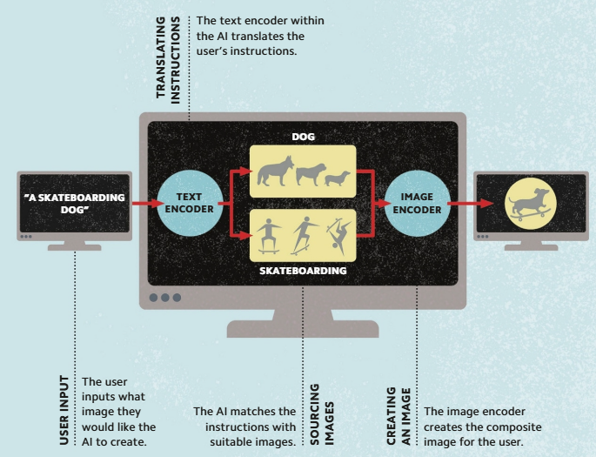
Al ARTISTS - GENERATIVE Al
Generative Al is the field dedicated to synthesizing new content, such as images, audio, text, or video, based on an input in any of these formats.
Recently, however, generative adversarial networks have proved such effective “artists” that they have prompted debate about whether art can be considered uniquely human.

Slide 29

INTELLIGENT ROBOTS - EMBODIED Al
Als that are designed to interact physically with their environments are known as "embodied Als.“
Such Als, which include robots, mimic not only human cognitive intelligence, but human physical behavior as well. They do so with the help of sensors, motors, and other hardware, which enable them to perceive move in, and affect their three-dimensional environments.
Constructing such machines is an important step forward in Al, since much of what we consider to be intelligence in human beings involves our ability to interact with our surroundings.

Slide 30
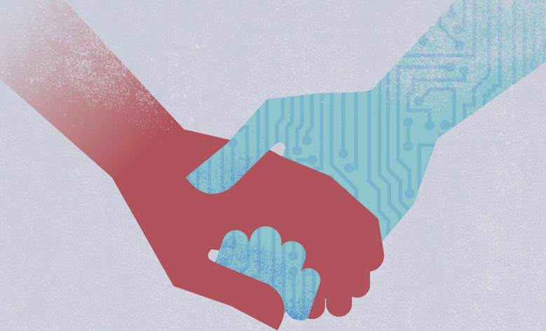
Al COMPANIONS - SOCIAL ROBOTS
A social robot is an embodied that is capable of interacting socially with humans, using speech, movement, facial expressions, and other humanlike behaviors.
Social robots are limited as companions, since it is difficult to replicate many basic human abilities, such as manipulating objects or understanding tone of voice.
While largely treated as a novelty, they are nevertheless sometimes used in health and social care to alleviate loneliness, depression, and anxiety.

Slide 31
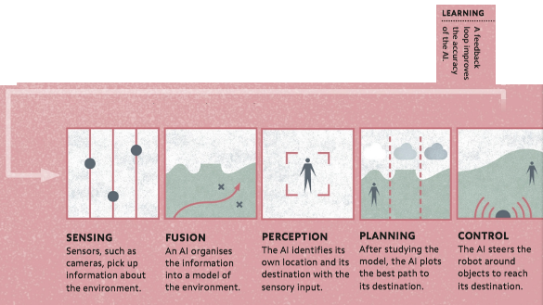
MOVEMENT AND MOBILITY - PHYSICAL INTERATIONS
Many robots are kept in stationary positions, such as on production lines, but some, such as unmanned rovers, can move around and explore their environments.
These mobile robots have varying degrees of autonomy: some are controlled remotely by human Beings, while others can navigate without human intervention.
A fully autonomous robot has an Al that can process data collected by sensors, such as optical cameras and LIDAR to plan the path ahead.

Slide 32
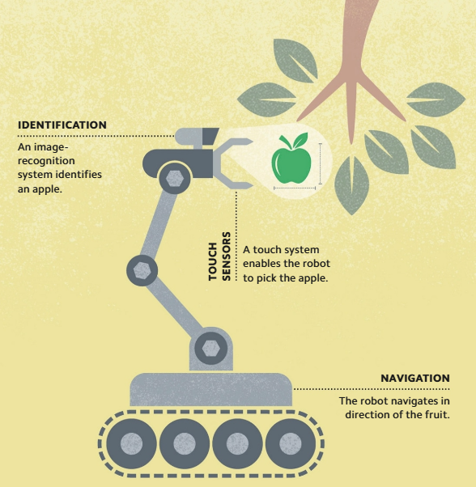
MANUAL DEXTERITY - PHYSICAL INTERACTIONS II
One of the greatest challenges in robotics is building machines that can interact physically with their environments.
To perform even the simplest human action, such as picking an apple, a robot must have an excellent sense of sight, as well as a sense of touch, which enables it to apply just the right amount of pressure to manipulate objects correctly.
Many such robots are currently used in controlled settings, such as factories, but they may soon be sophisticated enough to help with domestic chores in people's homes.

Slide 33
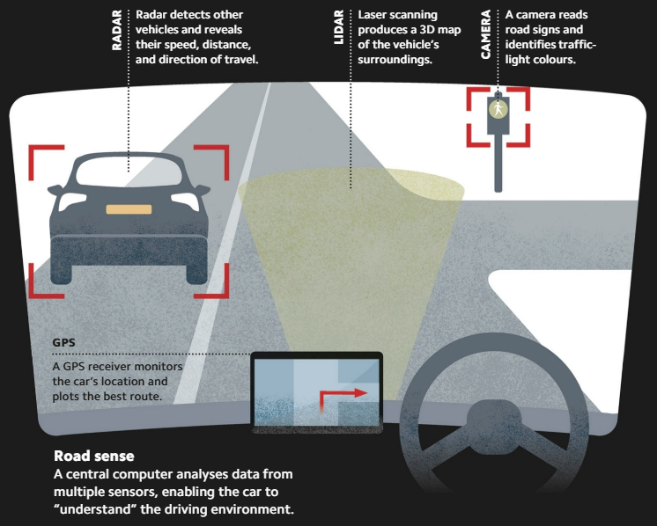
DRIVERLESS CARS - AUTONOMOUS VEHICLES
Autonomous vehicles are examples of mobile robots. They use systems incorporating sensors, Al, and actuators to assist or wholly replace the human operator of a vehicle, whether on land or sea, or in the air.
"Self-driving" or "driverless" cars are a category of autonomous vehicle under development, and cars incorporating semi-autonomous technology are now available.

Slide 34
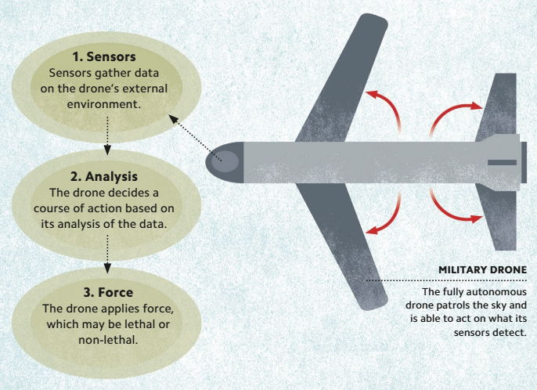
Al AND WARFARE - AUTONOMOUS WEAPONS
Military needs drive much Al innovation.
This has led to the creation of sophisticated autonomous systems that can perform military tasks with little or no human intervention.
Some, including reconnaissance drones, are nonlethal. Others, such as sentry guns, are deadly weapons in their own right capable of identifying, locking onto, and firing at targets.
There is much debate over whether to ban the deployment of lethal weapons that are fully autonomous—those that enable rapid response by removing the need for a human to give the final order to attack.

